Slide 1


How to use this project charter?
This charter can be used as a stand-alone resource or alongside existing organizational templates. It is a structured template that builds on the Model for Improvement, adding sustainability prompts to standard project charter components. Each slide includes accompanying speaking notes with additional details for each step.
Follow the prompts in each step to embed a sustainability lens
This project charter uses the Sustainability-Embedded Quality Improvement (SE-QI) approach, where sustainability is built into existing QI steps, not added as a separate process. Prompts are integrated throughout core components such as scope, problem statement, and measurement.
Use the SE-QI Toolkit to deepen your understanding of potential sustainability links
The SE-QI Toolkit is an important resource supporting this charter. At key steps, a visual marker (SE-QI icon and QR code) indicates where using the Toolkit can help teams more effectively apply and deepen sustainability within their project.
Consult the example at the end of the project charter for inspiration
To illustrate how the charter can be completed, an example - “Surgical Tray Optimization”- follows the project charter slides (beginning on slide 25)
Navigation
CASCADES Project Charter | Page 1

Slide 2

Add title here
Developed in collaboration with:
Add any collaborators here
Team members:
Add recommended team members here (ex. doctors, nurses, pharmacists, procurement staff, Medical Device Reprocessing Department (MDRD) staff)
Executive Sponsor: Add name of executive sponsor here
Notes:
Title Slide: Introduce the project
Modify to suit your needs!
Add attributions to authors, reviewers, and/or collaborators, and replace the logos with your own. Be sure to replace the photo with one that applies to your project.
A list of suggested collaborators has been provided – replace these with the names of project participants.
Finding an executive sponsor for your project will increase your chances of success – include their name on the title slide as well.
You can view several completed Sustainable Perioperative Care Project Charters here: https://drive.google.com/drive/folders/1rZELuMHIOTHPivCCUCI1ReB98vZONwXj
These can be downloaded and modified to suit your needs

Slide 3
1
Goal
Tool: SMART framework for goal setting
4
6
7
10
12
15
17
19
23
2
Scope
Tool: Project & Environmental Scope
A modifiable PowerPoint version of this project charter is available for download to support ease of completion for your project.
Please contact CASCADES@utoronto.ca if you have any questions
3
Problem/opportunity statement
Tool: Sustainable Health Systems Principles
Tool: 5W2H Method
4
Current state of the system/process
Tool: Process Map
5
Root cause analysis
Tool: 5 Why’s
Tool: Ishikawa Diagram
6
Design the improvement & define change ideas
Tool: Driver Diagram
7
Measure & test impact
Tool: Activity vs Impact Data
NAVIGATION
8
Embed & spread
Tool: SBAR
Tool: insights from climate psychology to health care
References
v. 04-2026
Notes:
Navigation Slide
Be sure to update the page numbers if you add or remove slides
Adding links to specific pages within the deck can make it easier to navigate. Links have been provided; please be sure to adjust these as needed.

Slide 4
Goal
1
What do you want to achieve?
[Ex: Reduce x (product/practice) used in x (department/service/practice) by x (amount in #/%) by x time]
Navigation
Notes:
Goal: A brief note on what you are trying to achieve
Craft this statement to specify quantitative targets, timelines, etc. (the SMARTer, the better!)

Slide 5
Goal
1
Tool: SMART framework for goal setting
S
M
A
R
T
SPECIFIC
MEASURABLE
ACHIEVABLE
RELEVANT
TIME-BOUND
Concrete and tangible
Metrics to measure progress and success
Realistic and attainable
Aligns with broader organizational goals/objectives
Clear deadline
Navigation
Notes:
SMART statements should be specific, measurable, achievable, relevant, and time-bound. Learn more about developing a SMART aim statement here: https://www.rcplondon.ac.uk/file/781/download?token=1o-_b67I

Slide 6
Scope
2
Define the limits of what you want to be included in the project and consider the environmental impacts you are targeting for change.
Project Scope: [Indicate what departments or services are included]
Environmental Scope: [Clarify what environmental impact categories are involved.]
  GHG: The project can seek to reduce Scope 1, 2, and/or 3 emissions.
    Scope 1: Emissions that fall under the direct control of the healthcare facility (i.e. on-site fuel combustion, fleet vehicles, anesthetic gas use and leaks)
    Scope 2: Emissions that derive from energy (mostly electricity) purchased by the facility
    Scope 3: All other indirect emissions (i.e. embedded carbon in purchased supplies and equipment, employee commuting, waste disposal).
  Other environmental impact categories (if applicable):
Navigation
Notes:
2. Scope: A boundary around the project to denote what is being included/ excluded.
a) Project Scope: Indicate what is included/excluded from a project perspective
You may want to start with a smaller boundary (i.e. reducing unnecessary glove use for one or two specific procedures/processes) or you could think about including multiple relevant units if the project has wide applicability (a glove reduction project, for example, translates well to other hospital units)!
b) Environmental scope: Clarify what environmental impact categories are involved. Most projects will consider GHG emissions (usually expressed as “CO2e” with “e” standing for “equivalent”), but it is worth noting that many sustainability opportunities involve environmental impacts beyond GHG emissions, such as ecotoxicity, water scarcity, emissions of particulate matter, etc. You can find a description of impact categories here: https://ecochain.com/blog/impact-categories-lca/ (See Table 1. Environmental impacts)
When it comes to GHG specifically, indicate the type of greenhouse gas (GHG) emissions the project seeks to reduce; as per the GHG Protocol, these include:
Scope 1: Emissions that fall under the direct control of the healthcare facility (i.e. on-site fuel combustion, fleet vehicles, anesthetic gas use and leaks)
Scope 2: Emissions that derive from energy (mostly electricity) purchased by the facility
Scope 3: All other indirect emissions (i.e. embedded carbon in purchased supplies and equipment, employee commuting, waste disposal). Most sustainable QI projects will address scope 3 emissions.

Slide 7
Problem/Opportunity Statement
Complete Step 1, to determine which sustainable healthcare principles apply to your project.
3
Briefly state the problem you want to solve or the opportunity you want to realize.
a) Identification of co-benefits: [Describe sustainability and quality co-benefits associated with this opportunity]
Category | Benefits | Rationale (for any applicable items)
Sustainable health system principle(s) applicable to your project | Prevention (reduce demand for health services)
 | Stewardship (match supply of health services to demand)
 | Decarbonization (reduce emissions, or other form of pollutant, from supply of health service)
Quality co-benefits/dimensions applicable to your project: | Safety
 | Effectiveness
 | Patient-centeredness
 | Efficiency
 | Timeliness
 | Equity
Navigation
Notes:
3. Problem/opportunity statement: A brief statement of the problem or opportunity you are trying to address or harness
Identify co-benefits: As a first step in defining the problem or opportunity, identify the sustainability and quality co-benefits you anticipate.
The SE-QI Toolkit (Step 1) can help you determine which sustainable health system principles are applicable to your project: prevention, stewardship, and/or decarbonization.
In terms of quality domains, those presented here are based on the Institute of Medicine framework; these can be adapted to align with the quality framework used in your organization. It is important to clearly articulate which dimensions of quality your project is addressing or advancing, alongside the environmental component.
For any applicable benefits, jot down some notes (you will use these ideas in crafting your problem/opportunity statement).
Note that some items may not apply – leave the rationale section blank for these items, or remove those rows entirely
You may elect to hide or remove this slide for presentations or circulation.

Slide 8
Problem/Opportunity Statement
3
Briefly state the problem you want to solve or the opportunity you want to realize.
  [b) Provide background information that justifies the need to act: [Add text here]
Navigation
Notes:
3. Problem/opportunity statement: A brief statement of the problem or opportunity you are trying to address or harness (con’t)
b) Craft your statement: Include background information to make the case for change. Cite the literature and provide references.
Augmenting this general information with site-specific data (for example, the number of disposable gloves your unit throws away on a monthly basis) will reinforce the need for action.
Use the sustainability principles and co-benefits you identified on the previous slide to make your case.
Duplicate this slide if you need more room for text

Slide 9
Problem/Opportunity Statement
3
Tool: 5W2H Method (What, Why, Where, Who, When, How and How often?)
What? | What is the problem or opportunity that needs to be addressed?
Why? | Why is this a problem or opportunity worth addressing?
Where? | Where is the problem or opportunity observed?
Who? | Who is impacted or involved in the process?
When? | When was the problem or opportunity first identified?
How? | How is the problem or opportunity observed or measured?
How often? | How often is the problem observed, or opportunity missed?
A problem statement clearly defines the issue a team aims to address. It focuses on identifying the actual problem or opportunity, defined as the gap between current and desired states, rather than just its symptoms.
Source: Tague, N. R. (2005). The quality toolbox (2nd ed.). Milwaukee, WI: ASQ Quality Press.
Navigation
Notes:
The 5W2H method — which stands for who, what, when, where, why, how, and how much — provides a structured approach to defining problems (Tague, 2005).
Source: Tague, N. R. (2005). The quality toolbox (2nd ed.). Milwaukee, WI: ASQ Quality Press.

Slide 10
Current State of the System/Process
4
What do things look like today?
[Add text in point form or use flow charts to map out your process. Discuss the process at each of your respective sites and try to come up with a general flow that is likely to apply (with some variation) at most sites]
Navigation
10
Notes:
4. Current State: A depiction of the current process or system in question
By plotting out the steps in your workflow, you will be better able to identify pain points and opportunities for change. Depicting your workflow as a process map will allow you to better capture complexity.
This video is a good introduction to the role of process mapping in QI: https://www.youtube.com/watch?v=z1L0ZGXyoWU

Slide 11
Current State of the System/Process
4
Tool: Process Map
Start
Activity
Activity
Activity
What: Visual tool showing each step and decision point in a process. Helps teams understand how a process currently works.
How:
List steps and decision points, and connect them with arrows to show flow
Use:
Identify delays, duplication, communication gaps, or non-value-adding steps
Delay
Activity
Delay
Activity
Decision
Point
No
Activity
Activity
End
Key:
Start
Activity
Yes
Activity
End
Delay
Decision
Point
Source: https://www.ihi.org/sites/default/files/QIToolkit_Flowchart.pdf
.
Navigation
11
Notes:
A process map is a pictorial representation of how things flow through a healthcare system from beginning to end (e.g., patient flow, information flow, lab request flow)
It should include all the activities (processes, people) required to complete a process (e.g., treat a condition, deliver a product or service)
Note that higher-level process maps tend to be less detailed than lower-level maps
Process maps can be used to:
Highlight any inefficiencies in the current system (i.e., waste, flow issues, examples of variability, overburden of work)
Check to see if a process is still going well or has "deteriorated”
Provide a great framework for opportunity identification and solution development
Determine what might get in the way of making change
Steps to building a process map:
Observe & learn the process & talk to the people involved​
Determine the scope (boundaries) of the process
Write each activity (starting with a verb), delay and decision point
Place each activity in the sequence that it occurs ​
Walk through the process to validate common understanding and correct any errors​
Draw flow lines once process has been validated
Understand by asking questions to uncover opportunities for improvement in the process​
If you are working with a multi-site team to create a process map, discuss the process at each of your respective sites and try to come up with a general flow that is likely to apply (with some variation) at most sites.

Slide 12
Root Cause Analysis
5
What gets in your way?
Identify factors contributing to the problem
1. Education & Awareness
  [add text here]
2. Clinical workflow
  [add text here]
3. Infrastructure
  [add text here]
4. Finances & Procurement
  [add text here]
5. Other
  [add text here]
12
Navigation
12
Notes:
5. Root Cause Analysis: Identify factors contributing to the problem
An overview of the factors contributing to the current state of the process or system as depicted in the previous step
Thoughtful identification of root causes is necessary to develop change ideas that will lead to improvement
Consider grouping your root causes into the following themes (these have been added to the slide above, but please modify accordingly by removing or changing categories)
Education and awareness
Many care providers are not aware of the sustainability implications of their practice; bringing attention to the problem and its possible solution(s) is often the first step in implementing change
Clinical workflow
Striving to fit proposed sustainability interventions into current processes will minimize workflow disruption
Clinicians who have developed preferences for less sustainable processes or products need incentivization to trial and accept more sustainable alternatives
Planning, implementing, and evaluating sustainability efforts takes time; integrating sustainability into the portfolio of existing personnel, developing a green team, and/or leveraging or hiring hospital sustainability staff are a few of the ways this work can be supported
Proposed changes must be evidence-based in order to assuage quick-to-arise concerns that sustainability interventions will compromise the quality of care
Policy-review/changes may be required to embed sustainability efforts
Infrastructure
Changes to the physical environment are often required to support sustainability interventions
The strategic placement of both products and disposal receptacles can make doing the sustainable thing the easy thing
Finances and procurement
Demonstrating that sustainability interventions will be cost-neutral or result in savings (either immediately or over time) can be key to generating buy-in
Interventions that involve substituting products with more sustainable alternatives require new or amended purchasing practices/contracts
These themes may not work for you, and you may find some of the root causes more relevant than others – remove and add to this section as you see fit. Thoughtful identification of root causes is necessary to develop change ideas that will lead to improvement; the following tools from the Institute for Healthcare Improvement can assist in this endeavour.
Cause & Effect Diagram: https://www.ihi.org/resources/tools/cause-and-effect-diagram
5 Whys: https://www.ihi.org/resources/tools/5-whys-finding-root-cause

Slide 13
Root Cause Analysis
5
Tool: 5 Why’s
The 5 Whys tool: Helps identify root causes of an issue by repeatedly asking “Why?”
Start with a clear problem statement and build upon each answer until the fundamental cause is uncovered.
Keep asking “why?”
The final “because” you land on should be something over which you have control
WHY ____________________? [add first question here]
Why #1
Why #2 | .
Why #3
Why #4
Why #5
Source: https://www.ihi.org/library/tools/5-whys-finding-root-cause
13
Navigation
13
Notes:
The 5 Whys tool: Helps identify root causes of an issue by repeatedly asking “Why?” Start with a clear problem statement and build upon each answer until the fundamental cause is uncovered.
Keep asking “why?”
The final “because” you land on should be something over which you have control

Slide 14
Root Cause Analysis
5
Tool: Ishikawa Diagram (Cause and Effect Diagram)
Education and awareness
Infrastructure
Category
Cause
Cause
Cause
Cause
Cause
Cause
Problem/Issue
Cause
Cause
Cause
Cause
Clinical flow
Finances and Procurement
Source: https://www.ihi.org/library/tools/cause-and-effect-diagram.
14
Navigation
14
Notes:
You may want to depict cause and effect using a fishbone (or “Ishikawa”) diagram; this is “an organizational tool that helps teams explore and display the many causes contributing to a certain effect or outcome. It graphically displays the relationship of the causes to the effect and to each other, helping teams identify areas for improvement.” (IHI) You can use the themes introduced on the previous slide (education and awareness, clinical flow, infrastructure, finances and procurement, other) to structure your diagram, or try to come up with new ones to see if this yields other ways of thinking about challenges.
Consult these resources from IHI to learn more and access a template:
https://www.ihi.org/resources/tools/cause-and-effect-diagram
https://www.ihi.org/sites/default/files/SafetyToolkit_CauseandEffectDiagram.pdf

Slide 15
Design the Improvement & Define Change Ideas
Complete Step 2, to explore sustainability opportunities that can be relevant to your project
6
What are your ideas to achieve your goals, address your root causes and close the gap from your problem statement?
Identify change ideas that can be tested in an effort to address the barriers identified in the root cause analysis
1. Education & Awareness
  [add text here]
2. Clinical workflow
  [add text here]
3. Infrastructure
  [add text here]
4. Finances & Procurement
  [add text here]
5. Other
  [add text here]
15
Navigation
15
Notes:
6. Design the improvement and define change ideas: Explore opportunities to address the problem
Create a list of change ideas that can be tested in an effort to address the barriers identified in the root cause analysis
Consider grouping your root causes into the same themes used in your root cause analysis (these have been added to the slide above, but please modify accordingly by removing or changing categories)
List any known resources or tools that could be used to implement these change ideas, or items that would be helpful and might need to be developed

Slide 16

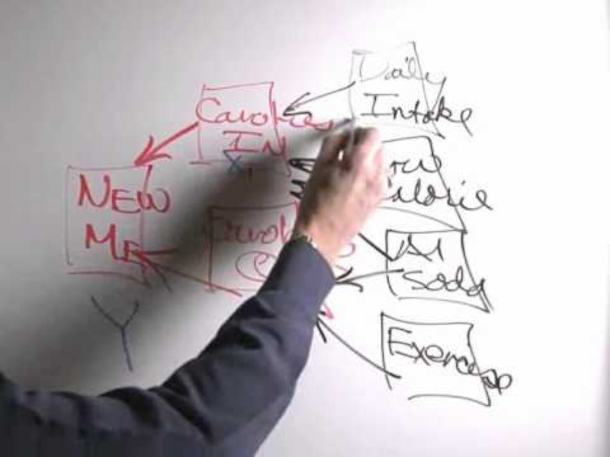
Design the Improvement & Define Change Ideas
6
Tool: Driver Diagram
A driver diagram visually outlines how a project’s overall aim connects to the key factors that influence it (referred to as primary drivers) along with their supporting elements (secondary drivers), and specific change ideas linked to each of those components.
Aim Primary Drivers Secondary Drivers Change ideas
Source: https://www.ihi.org/library/tools/driver-diagram
16
Navigation
16
Notes:
A driver diagram visually outlines how a project’s overall aim connects to the key factors that influence it (referred to as primary drivers) along with their supporting elements (secondary drivers), and specific change ideas linked to each of those components. In orange, you can include the different change ideas.

Slide 17
Measure & Test Impact
Complete Step 3 to identify potential activity and environmental metrics to incorporate into your project.
7
How will you estimate the environmental impact of your changes?
[a) Identify outcome, process, and balancing measures]
Outcome Measures
  [add text here]
Process Measures
  [add text here]
Balancing Measures
  [add text here]
Navigation
17
Notes:
7. Measure & Test Impact: Devise strategies to assess whether the change idea is an improvement
Identify outcome, process, and balancing measures
Outcome Measures
Where are we ultimately trying to go?
Are the changes leading to improvement?
Process Measures
Are we doing the right things to get there?
Measures of the workings of the system
Balancing Measures
Are the changes we are making to one part of the system causing problems elsewhere?
Measures of other parts of the system

Slide 18
Measure & Test Impact
7
Tool: Activity and environmental data
Activity/Outcome Metric
Related Environmental Metric
Environmental savings
Considerations:
This calculation should give you an estimate of the environmental savings associated with your work.
The calculation will yield ESTIMATES only.
Use the Natural Resources Canada Greenhouse Gas Equivalencies Calculator to translate your results to stakeholders.
Source(s):
Considerations:
Source(s):
Considerations:
Navigation
18
Notes:
7. Measure & Test Impact: Devise strategies to assess and maximize these opportunities (con’t)
b) Devise a formula to estimate the environmental impacts of an intervention using activity data and environmental impact data
There are two types of data you need to get a basic understanding of environmental impact:
1. Activity Data: Data associated with an activity that generates GHG emissions
This type of data is referred to as “outcome measures” in QI
You will be able to generate reliable activity data
Ask the following questions to establish needed metrics:
How much of x was used?
How much of x was purchased?
How much does x weigh?
How many times did you do x?
Jot down some ideas about where you might be able to obtain this activity data
2. Environmental Impact Data: Quantity of a pollutant released to the atmosphere
in association with the activity
Short of conducting an LCA of your own, you will need to rely on published environmental impact data (look to the literature, reports, or the Healthcare LCA database)
As this data has been generated in other settings, it has limited applicability (limitations should be noted)
Be sure to report any environmental savings indicated from calculations like these as estimates only. Changes in activity data are often enough to show you are improving sustainability!
Ask the following questions to establish needed metrics:
How much CO2e (or other unit of environmental impact) is produced per unit of time for a given activity?
How much CO2e (or other unit of environmental impact) is produced per product or per weight?
If you do present estimates of environmental savings arising from your interventions, it is advisable that you use equivalencies (such as km driven or homes powered) to demonstrate their significance using tools like the Natural Resources Canada GHG Equivalencies Calculator.
Review examples of activity and environmental metrics in the Sustainable Perioperative Care Project Charters: https://drive.google.com/drive/folders/1rZELuMHIOTHPivCCUCI1ReB98vZONwXj

Slide 19
Embed & Spread
8
What steps have been taken to ensure lasting change? How could it be spread to other contexts?
Micro (What can you do?)
  [add text here]
Meso (What can you do within your organization?)
  [add text here]
Macro (What can your organization do?)
  [add text here]
19
Navigation
19
Notes:
8. Embed and Spread: Devise strategies maximize change ideas
Create a list of ways to ensure lasting change at various levels, including:
Micro (individual/department)
Meso (institutional)
Macro (system/policy)
Consider your own sphere of influence and desired area(s) of focus.

Slide 20
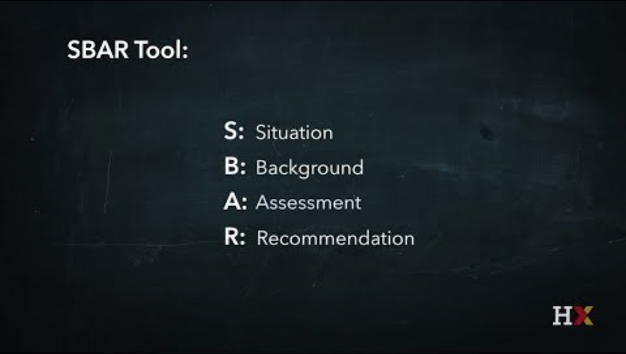
Design the Improvement & Define Change Ideas
8
Tool: SBAR
The SBAR (Situation–Background–Assessment–Recommendation) technique can be applied as a tool to communicate and scale projects with a sustainability lens or co-benefit.
S
B
A
R
SITUATION
BACKGROUND
ASSESSMENT
RECOMMENDATION
Concise statement of problem
Brief and pertinent information related to situation
Analysis and considerations of options
Actions requested or recommended
Source: SBAR Tool Overview and Example - YouTube
20
Navigation
20
Notes:
The SBAR (Situation–Background–Assessment–Recommendation) technique can be applied as a tool to communicate and scale projects with a sustainability lens or co-benefit.

Slide 21
Design the Improvement & Define Change Ideas
8
Tool: Applying insights from climate psychology to health care
Psychological lesson | In Practice
The human brain privileges experience over analysis | Highlight relevant personal experiences through affective recall, stories, and metaphors
People are social beings who respond to group norms | Activate and leverage relevant social group norms to promote and increase collective action
Out of sight, out of mind: Reduce psychological distance | Emphasize the present and make climate change impacts and solutions locally relevant
Framing the big picture: Nobody likes losing but everyone likes gaining | Frame solutions in terms of what can be gained (not in terms of what is lost)
Playing the long-game: Tapping the potential of human motivation | Leverage intrinsic motivation to support long-term environmental goals
https://journals.sagepub.com/doi/abs/10.1177/1745691615598516?journalCode=ppsa
21
Navigation
21
https://journals.sagepub.com/doi/abs/10.1177/1745691615598516?journalCode=ppsa
Notes:
https://journals.sagepub.com/doi/abs/10.1177/1745691615598516?journalCode=ppsa
Go through each “lesson” – for each, consider how the lesson might be applicable in your healthcare settings…
#1 – this is really woven throughout the others
The human brain privileges experience over analysis
“Because climate change can only be studied in statistical terms (e.g., by analyzing long-term changes in temperature and precipitation patterns), the issue is generally communicated and presented in relatively abstract, descriptive, and analytical formats. This approach, however, relies on the assumption that people process uncertain (climate) information in a logical and analytical matter (Marx et al., 2007). Yet, decades of research in social, cognitive, and clinical psychology has shown that the human brain relies on two qualitatively different processing systems (Chaiken & Trope, 1999; Evans, 2008; Sloman, 1996). The first system (i.e., System 1) is often described as intuitive, experiential, automatic, affective (emotional), and fast. System 2, on the other hand, is deliberate, analytical, effortful, rational, and slow (Kahneman, 2012). In practice, these two systems continually interact and operate in parallel to guide human judgment and decision making (LeDoux, 1989). Yet, when they diverge, System 1 often exerts a greater influence in guiding human decision making (Loewenstein, Weber, Hsee, & Welch, 2001).”
Health System implications:
Enagage patients, physicans, nurses, managers, staff in conversations about their everyday lived experiences - what are some opportunities for sustainability interventions? How might these improve experience?
Proximity to climate-related health impacts can induce action
Observations of waste in practice can prompt action (more apparent in some areas than others)
Tell stories about sustainability interventions happening elsewhere you admire or would like to model an intervention after - we can learn from/be inspired by the experiences of others. VALUE OF CASE STUDIES
People are social beings who respond to group norms
“Because climate change is a global problem with global consequences, peoples’ sense of personal efficacy (i.e., the belief that individual actions can make a difference) is often very low (Kerr & Kaufman-Gilliland, 1997). Indeed, the global nature of the climate change problem tends to make people feel powerless. Instead, it is often more effective to appeal to and leverage the social context in which people make decisions, particularly to help promote collective efficacy (i.e., the belief that group actions can make a difference; Roser-Renouf, Maibach, Leiserowitz, & Zhao, 2014). Humans evolved living in social groups, and it is through social comparison with referent others that people validate the correctness of their opinions and decisions (Festinger, 1954).”
Health System Implications:
Try to leverage established group norms by tying sustainability interventions to existing institutional commitments (such as to Choosing Wisely Canada, Quality Improvement efforts, etc.)
Leverage commitment to “Do no harm” – this also includes to the environment upon which human health depends
Do healthcare providers have a responsibility to engage in climate action?
Call attention to (successful) sustainability interventions at other institutions in an effort to establish sustainability as a ""group norm"" within the wider healthcare community this is happening at a lot of other places – why aren’t we doing it?
Can also link to activities outside of health sector that can be connected (COP26/COP27)
Out of sight, out of mind: Reduce psychological distance Going from theoretical to lived experience
“Discourse among scientists, the media, and policymakers has largely revolved around the future consequences of climate change over varying time scales (e.g., 50 to 150 years). Yet, this focus is problematic, as psychological research has shown that people tend to heavily discount (uncertain) future events when making trade-offs between cost and benefits that accrue at different points in time (i.e., intertemporal choices; Berns, Laibson, & Loewenstein, 2007). In fact, the discounting of future risk events is a pervasive feature of the way in which human psychology evolved; immediate day-to-day concerns take precedence over planning for the future (van Vugt, Griskevicius, & Schultz, 2014)… In addition to temporal discounting, people discount risks “spatially” as well. For example, research across 18 nations has found that many people systematically judge the risks of climate change to be much more likely and more serious for other people and places than for themselves (Gifford et al., 2009; Leiserowitz, 2005; van der Linden, 2014b).”
Health System Implications:
Try to connect specific practices to outcomes (i.e. anesthetic gases WE use are GHGs; therefore WE are contributing to climate change in this very concrete way)
Call attention to sustainability interventions in similar institutions/your area to make them seem more relatable. Following Mabaj and B - Emphasize climate change as both a public health concern and responsibility (vs. an abstract environmental problem)
COVID also helped do this by showing issues with PPE waste, supply chain vulnerabilities and the importance of local sourcing, and the impact of high volumes
Call attention to climate shocks already happening in parts of Canada (esp. BC), and the ways in which these are impact health care delivery
Framing the big picture: Nobody like losing but everyone likes gaining
“Much of the media, scientific, and policy discourse around climate change has consistently invoked the idea of “losses.” For example, climate solutions are often framed as an immediate loss for society (e.g., higher taxes, reducing energy consumption). Yet, long-standing behavioral research has shown that people psychologically evaluate gains and losses in fundamentally different ways. For example, prospect theory (Kahneman & Tversky, 1979) demonstrates that people are more risk-seeking in loss domains than they are in gain domains. In particular, people are more reluctant to take action when losses are paired with uncertainty (Tversky & Shafir, 1992). In other words, when climate change impacts are framed as potential (i.e., uncertain) losses in the distant future, whereas climate change solutions are framed as certain losses for society at present, it encourages people to conclude that maintaining the status quo may be “worth the gamble.””
Health System Implications
Losses are already happening (reduced capacity in some parts of Canada due to climate shocks)
Reputation for innovation and environmental sustainability; Improved patient experience; Cost recovery; Time savings
These psychological insights suggest that shifting the policy conversation from the potentially negative future consequences of not acting (losses) on climate change to the positive benefits (gains) of immediate action is likely to increase public support. In fact, in comparison with negative loss scenarios, positive gain frames have shown to increase pro-environmental attitudes and support for mitigation and adaptation policies (Hurlstone, Lewandowsky, Newell, & Sewell, 2014; Spence & Pidgeon, 2010).
Possible co-benefits of sustainability action in healthcare:
Regulatory compliance
Community engagement
Patient engagement
Broader commitments (e.g. Choosing Wisely)
Cost savings
Efficiencies
Innovation
Employee engagement and satisfaction
Reduced risk and liability
Improved quality and safety
Public image enhancement
Playing the long-game: Tapping the potential of human motivation
“Psychologists generally distinguish between two separate sources of motivation: extrinsic and intrinsic. Whereas the former mainly relies on external incentives to produce motivation to change (e.g., monetary incentives), the latter draws on personal and internal processes. In contrast to the predominant assumption among many policymakers that people are inherently (or rationally) motivated by money (Miller, 1999), a large body of psychological research has illustrated that this is not necessarily the case—many people intrinsically care about the well-being of others and the environment (Stern, Dietz, Abel, Guagnano, & Kalof, 1999). Accordingly, recent experiments have shown that appealing to people’s intrinsic motivational needs can be a more effective and long-lasting driver of pro-environmental behavior (Bolderdijk, Steg, Geller, Lehman, & Postmes, 2013; van der Linden, 2015).”
Health System Implications:
Internal: Hope vs. Worry: Building a sense of urgency that induces motivation (not fear or complacency) - hope is not only a pleasant feeling but could also work as a motivational force
Lots of people cite their kids caring about this, showing them it matters; Indigenous principle of seventh generation – help us to care about the future
Internal: other-oriented values of both an altruistic kind – for instance valuing justice and equality highly – and a biospheric kind – for instance valuing environmental protection and living in harmony with nature highly. “At our core, we all ultimately want to leave the planet a better place for future generations; to live in a world of purpose and ultimately live a life of impact."
External: Competitions, awards - external rewards

Slide 22
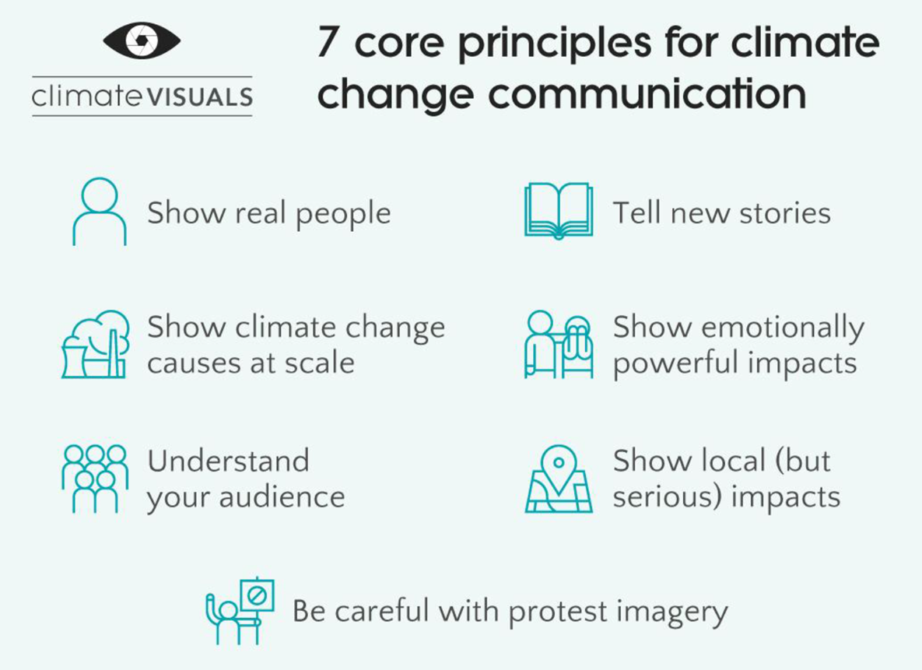
Design the Improvement & Define Change Ideas
8
Tool: Applying insights from climate psychology to health care
https://climatevisuals.org/evidence/
22
Navigation
22
https://journals.sagepub.com/doi/abs/10.1177/1745691615598516?journalCode=ppsa
Notes:
Also want to consider these 7 core principles for climate change communication
1. Show ‘real people’ not staged photo-ops
A person expressing an identifiable emotion is powerful. But our discussion groups favoured ‘authentic’ images over staged photographs, which they saw as gimmicky or even manipulative. Politicians – notoriously low on credibility and authenticity – attracted some of the lowest scores (in all three nations) in our survey.
2. Tell new stories
Images that participants could quickly and easily understand – such as smokestacks, deforestation, and polar bears on melting ice – tended to be positively rated in our online survey (which captured rapid responses to images, rather than deeper debate). Familiar, ‘classic’ images may be especially useful for audiences with limited knowledge or interest in climate change, but they also prompted cynicism and fatigue in our discussion groups. They are effective ways of communicating to an audience that ‘this story is about climate change’. But is it a story they want to hear? Less familiar (and more thought-provoking) images can help tell a new story about climate change, and remake the visual representation of climate change in the public mind.
3. Show climate causes at scale
We found that people do not necessarily understand the links between climate change and their daily lives. Individual causes of climate change (such as meat-eating) may not be recognised as such, and if they are, may provoke defensive reactions. If communicating the links between ‘problematic’ behaviours and climate change, it is best to show these behaviours at scale – e.g. a congested highway, rather than a single driver.
4. Climate impacts are emotionally powerful
Survey participants in all three nations were moved more by climate impacts – e.g. floods, and the destruction wrought by extreme weather – than by causes or solutions. Images of climate impacts can prompt a desire to respond, but because they are emotionally powerful, they can also be overwhelming. Coupling images of climate impacts with a concrete behavioural action for people to take can help overcome this.
5. Understand your audience
Unsurprisingly, levels of concern/scepticism about climate change determined how people reacted to the images we tested. But other differences emerged too – images of ‘distant’ climate impacts produced much flatter emotional responses among those on the political right. Images depicting solutions to climate change generated mostly positive emotions – for those on the political right, as well as those on the left.
6. Show local (but serious) climate impacts
When images of localised climate impacts show an individual person or group of people, with identifiable emotions, they are likely to be most powerful. But there is a balance to be struck (as in verbal and written communication) between localising climate change (so that people realise the issue is relevant to them) and trivialising the issue (by not making clear enough links to the bigger picture).
7. Be very careful with protest imagery
Images depicting protests (or protesters) attracted widespread cynicism and some of the lowest ratings in our survey. In our discussion groups, images of (what people described as) ‘typical environmentalists’ only really resonated with the small number of people who already considered themselves as activists and campaigners. Most people do not feel an affinity with climate change protesters, so images of protests may reinforce the idea that climate change is for ‘them’ rather than ‘us’. Protest images involving people directly affected by climate impacts were seen as more authentic and therefore more compelling.
compelling or evocative in this installation?

Slide 23
References
[List references here]
23
Navigation
23
Notes:
Providing links to references makes it easier for potential collaborators to review your sources

Slide 24
Example: Surgical Tray Optimization
24
Navigation
24
Notes:
Providing links to references makes it easier for potential collaborators to review your sources

Slide 25
Surgical Tray Optimization
Developed in collaboration with: CASCADES Canada
Team members:
Surgeons; Medical Device Reprocessing Department (MDRD; Sustainable Clinical Services; Data analysts
Executive Sponsor: Division Head, General Surgery

Slide 26
Goal
1
What do you want to achieve?
Example: Surgical Tray Optimization
By March 31, 2026, implement a standardized, evidence-informed process for surgical tray optimization in the General Surgery department at Hospital ABC, aiming to reduce the number of unused instruments per tray by 30%
Navigation

Slide 27
Scope
2
Define the limits of what you want to be included in the project and consider the environmental impacts you are targeting for change.
Project Scope: This project focuses on optimizing surgical tray configuration for elective procedures in the General Surgery departments at Hospital ABC. It includes collaboration with operating room staff, sterile processing departments, and procurement teams, with the goal of reducing unnecessary instruments in standard sets while maintaining clinical quality and safety.
Environmental Scope:
  GHG: Scope 3; these emissions arise from activities or products that are related to health sector activities, but not owned or controlled by the organization, such as pharmaceuticals and other medical products and devices
Navigation

Slide 28
Problem/Opportunity Statement
3
Briefly state the problem you want to solve or the opportunity you want to realize.
Example: Surgical Tray Optimization
a) Identification of co-benefits: [Describe sustainability and quality co-benefits associated with this opportunity]
Category | Benefits | Rationale (for any applicable items)
Sustainable health system principle(s) applicable to your project | Prevention (reduce demand for health services) | Not applicable
 | Stewardship (match supply of health services to demand) | Applicable- Right-sizing tray contents ensures resources used align with actual surgical needs, reducing overuse and waste.
 | Decarbonization (reduce emissions – or other form of pollutant –from supply of health service) | Applicable- Fewer instruments mean reduced energy, water, and sterilization chemicals used during reprocessing.
Quality co-benefits/dimensions applicable to your project: | Safety | Applicable- Reducing unnecessary instruments lowers tray complexity, reducing setup errors and contamination risks.
 | Effectiveness | Applicable- Streamlined trays ensure teams have exactly what is needed, supporting better procedural flow and outcomes
 | Patient-centeredness | Not applicable
 | Efficiency | Applicable- Reduced tray size lowers setup and sterilization time, and improves OR workflow efficiency
 | Timeliness | Applicable-Leaner trays reduce setup delays, improving surgical scheduling and OR turnover time.
 | Equity | Not applicable
Navigation

Slide 29
Problem/Opportunity Statement
3
Briefly state the problem you want to solve or the opportunity you want to realize.
Example: Surgical Tray Optimization
Across surgical departments at Hospital ABC, instrument trays are overstocked with unused tools; resulting in increased sterilization load, energy and water use, and unnecessary setup time. Audits have shown that up to 50% of instruments are routinely unused. This presents a key opportunity to improve environmental sustainability, reduce costs, and streamline surgical workflow by optimizing tray configurations based on actual utilization.
Navigation

Slide 30
Current State of the System/Process
4
What do things look like today?
Example: Surgical Tray Optimization
Tray items identified
Tray ordered and prepared
Waiting on tray
Tray delivered to OR
Surgery performed
Start
Yes (~30%)
Yes (~10%)
Send item to MDRD for reprocessing
Tray item used?
Reusable?
End
No (~70%)
No (~90%)
Key
No (~80%)
Discard the item
Start
Activity
Reusable?
End
Delay
Decision
Point
Yes (~20%)
Navigation
30

Slide 31
Root Cause Analysis
5
What gets in your way?
Example: Surgical Tray Optimization
1. Education & Awareness
  People are unaware of the magnitude of unused instruments and the environmental impact of reprocessing unused items
  People are unaware of the benefits of optimizing trays, such as reduced reprocessing time, cost savings, and potentially reduced set up time
2. Clinical workflow
  Surgeons rely on individual preferences rather than standardized sets
  Variation in practice patterns between providers
  Many nurses and surgeons are accustomed to standard instrument trays. Some believe that instruments necessary for surgical procedures will be removed, impacting patient safety and workflow.
  A tray can used for different procedure types, but not all instruments from the tray are needed each time
3. Infrastructure
  Trays are built manually based on habit, not data
  If multiple trays are optimized at the same time, storage capacity may become a concern. It will take time to determine whether instruments can be redistributed to other trays missing the same items, or if they are common enough to justify being individually wrapped for future use.
4. Finances & Procurement
  Procurement processes are not linked to usage analytics
  Instruments are typically owned by the OR. If an optimized instrument is not needed to complete another tray or is not used frequently enough to be kept individually wrapped, the item may need to be recycled, or the option of donation can be explored.
31
Navigation
31
Notes:
5. Root Cause Analysis: Identify factors contributing to the problem
An overview of the factors contributing to the current state of the process or system as depicted in the previous step
Thoughtful identification of root causes is necessary to develop change ideas that will lead to improvement
Consider grouping your root causes into the following themes (these have been added to the slide above, but please modify accordingly by removing or changing categories)
Education and awareness
Many care providers are not aware of the sustainability implications of their practice; bringing attention to the problem and its possible solution(s) is often the first step in implementing change
Clinical workflow
Striving to fit proposed sustainability interventions into current processes will minimize workflow disruption
Clinicians who have developed preferences for less sustainable processes or products need incentivization to trial and accept more sustainable alternatives
Planning, implementing, and evaluating sustainability efforts takes time; integrating sustainability into the portfolio of existing personnel, developing a green team, and/or leveraging or hiring hospital sustainability staff are a few of the ways this work can be supported
Proposed changes must be evidence-based in order to assuage quick-to-arise concerns that sustainability interventions will compromise the quality of care
Policy-review/changes may be required to embed sustainability efforts
Infrastructure
Changes to the physical environment are often required to support sustainability interventions
The strategic placement of both products and disposal receptacles can make doing the sustainable thing the easy thing
Finances and procurement
Demonstrating that sustainability interventions will be cost-neutral or result in savings (either immediately or over time) can be key to generating buy-in
Interventions that involve substituting products with more sustainable alternatives require new or amended purchasing practices/contracts
These themes may not work for you, and you may find some of the root causes more relevant than others – remove and add to this section as you see fit. Thoughtful identification of root causes is necessary to develop change ideas that will lead to improvement; the following tools from the Institute for Healthcare Improvement can assist in this endeavour.
Cause & Effect Diagram: https://www.ihi.org/resources/tools/cause-and-effect-diagram
5 Whys: https://www.ihi.org/resources/tools/5-whys-finding-root-cause

Slide 32
Root Cause Analysis
5
What gets in your way?
Example: Surgical Tray Optimization
WHY ARE UNNECESSARY INSTRUMENTS INCLUDED IN SURGICAL TRAYS?
Why #1 | Because trays contain more tools than are typically used in a procedure.
Why #2 | Because each provider includes instruments they might need, based on personal preference.
Why #3 | Because there is no standardized list or evidence-based guideline for tray contents.
Why #4 | Because usage data is not routinely audited or analyzed to inform optimization.
Why #5 | Because there is no formal process or accountability structure in place for tray review and optimization.
32
Navigation
32

Slide 33
Root Cause Analysis
5
What gets in your way?
Example: Surgical Tray Optimization
Education and awareness
Infrastructure
Lack of awareness about the impact of unused instruments
Trays are built manually based on habit, not data
Belief that “more is safer” during surgery
Problem/Issue
Surgeons rely on individual preferences rather than standardized sets
Procurement processes are not linked to usage analytics
Variation in practice patterns between providers
Clinical flow
Finances and Procurement
33
Navigation
33

Slide 34
Design the Improvement & Define Change Ideas
6
What are your ideas to achieve your goals, address your root causes and close the gap from your problem statement?
Example: Surgical Tray Optimization
Aim Primary Drivers Secondary Drivers Change ideas
By March 31, 2026, implement a standardized, evidence-informed process for surgical tray optimization in the General Surgery department at Hospital ABC, aiming to reduce the number of unused instruments per tray by 30%
Reduce activity
Avoid unnecessary care
Build trays based on evidence-based protocols and case type, not habit or preference.
Reduce environmental intensity of the activity
Substitute reusable alternatives
Don’t use single-use/disposable items when a reusable option is available and less resource intensive
Reduce waste
Implement real-time tracking systems to monitor instrument use and flag low-use items
34
Navigation
34

Slide 35
Measure & Test Impact
Complete Step 3 to identify potential activity and environmental metrics to incorporate into your project.
7
How will you estimate the environmental impact of your changes?
[a) Identify outcome, process, and balancing measures]
Outcome Measures
  Reduction in CO₂e emissions per tray per year (kg CO₂e)
Process Measures
  Average number of instruments per tray
  % trays optimized according to new standard
Balancing Measures
  % of cases needing additional instruments
Navigation
35

Slide 36
Measure & Test Impact
7
How will you estimate the environmental impact of your changes?
Environmental impact was calculated from a combination of local data and published proxies from Rizan et al, 2023, where CO2 emission for each instrument was estimated using data from raw material extraction, transportation to primary processing/manufacturing site, steam sterilization, and disposal.(3) Their detailed method of calculation is outlined below.
Emission per Decontamination
Emissions from the decontamination process: Emissions were estimated for each tray, allocated across instruments within a tray according to instrument weight.
Raw material weight times Disposal-related emissions factor: Stainless steel (in tonne) times 21 kg CO2e/tonne
Raw material weight times Production-related emissions factor, ‘cradle to factory gate’:
Stainless Steel (in kg) times 6.15 kg CO2e/kg
Number of decontaminations sustainable before requiring replacement:
Specific to each instrument
Number of Decontaminations
Annual Environmental savings
Obtained the number of times the tray is decontaminated annually from the local Medical Devices Reprocessing Department. This is specific to each instrument tray.
The calculation will yield ESTIMATES only.
Use the Natural Resources Canada Greenhouse Gas Equivalencies Calculator to translate your results to stakeholders.
Navigation
36
Notes:
Source: Rizan C, Lillywhite R, Reed M, Bhutta MF. Minimizing carbon and financial costs of steam sterilization and packaging of reusable surgical instruments. Br J Surg 2021; 109: 200–10. https://doi.org/10.1093/bjs/znab406.

Slide 37
Embed & Spread
8
What steps have been taken to ensure lasting change? How could it be spread to other contexts?
Micro (What can you do?)
Conduct Plan–Do–Study–Act (PDSA) cycles to test the change ideas outlined in Step 6.
Meso (What can you do within your organization?)
Partner with surgeons to conduct a systematic review of trays on an ongoing basis.
Collaborate with MDRD to optimize trays and ensure changes are feasible and operationally sound.
Macro (What can your organization do?)
Engage affiliated sites to build buy-in and identify priority trays for optimization.
Disseminate learnings and results to support broader adoption and enable others to advocate for change.
37
Navigation
37

Slide 38
Embed & Spread
8
What steps have been taken to ensure lasting change? How could it be spread to other contexts?
Example: Surgical Tray Optimization
S – Situation
High numbers of unused instruments in surgical trays increase workload, costs, and environmental impact.
B – Background
Current tray assembly is based on habit or preference rather than evidence-based protocols. This leads to unnecessary care, reliance on disposables, and avoidable waste.
A – Assessment
Standardization and optimization of trays can reduce unused instruments by 30%, cut costs, and lower the environmental footprint.
R – Recommendation
Implement evidence-informed protocols, substitute reusable alternatives where possible, and use tracking systems to monitor and adjust instrument use.
38
Navigation
38

